Slide 1
Lexical Analysis
CSE 420
Lecture 02

Slide 2
Lexical Analysis
Basic Concepts & Regular Expressions
What does a Lexical Analyzer do?
How does it Work?
Formalizing Token Definition & Recognition
Reviewing Finite Automata Concepts
Non-Deterministic and Deterministic FA
Conversion Process
Regular Expressions to NFA
NFA to DFA
Relating NFAs/DFAs /Conversion to Lexical Analysis

Slide 3
Lexical Analyzer in Perspective
token
source program
lexical analyzer
parser
get next token
symbol table
Important Issue:
What are Responsibilities of each Box ?
Focus on Lexical Analyzer and Parser.

Slide 4
Lexical Analyzer in Perspective
LEXICAL ANALYZER
Scan Input
Remove WS, NL, …
Identify Tokens
Create Symbol Table
Insert Tokens into ST
Generate Errors
Send Tokens to Parser
PARSER
Perform Syntax Analysis
Actions Dictated by Token Order
Update Symbol Table Entries
Create Abstract Rep. of Source
Generate Errors
And More…. (We’ll see later)

Slide 5
What Factors Have Influenced the Functional Division of Labor ?
Separation of Lexical Analysis From Parsing Presents a Simpler Conceptual Model
A parser embodying the conventions for comments and white space is significantly more complex that one that can assume comments and white space have already been removed by lexical analyzer.
Separation Increases Compiler Efficiency
Specialized buffering techniques for reading input characters and processing tokens…
Separation Promotes Portability.
Input alphabet peculiarities and other device-specific anomalies can be restricted to the lexical analyzer.

Slide 6
Introducing Basic Terminology
What are Major Terms for Lexical Analysis?
TOKEN
A pair consisting of a token name and an optional attribute value.
A particular keyword, or a sequence of input characters denoting identifier.
PATTERN
A description of a form that the lexemes of a token may take.
For keywords, the pattern is just a sequence of characters that form keywords.
LEXEME
Actual sequence of characters that matches pattern and is classified by a token

Slide 7
Introducing Basic Terminology
Token
Sample Lexemes
Informal Description of Pattern
const
if
relation
id
num
literal
const
if
<, <=, =, < >, >, >=
pi, count, D2
3.1416, 0, 6.02E23
“core dumped”
const
characters of i, f
< or <= or = or < > or >= or >
letter followed by letters and digits
any numeric constant
any characters between “ and “ except “
Actual values are critical. Info is :
1. Stored in symbol table
2. Returned to parser
Classifies Pattern

Slide 8
Attributes for Tokens
When more than one lexeme can match a pattern, a lexical analyzer must provide the compiler additional information about that lexeme matched.
In formation about identifiers, its lexeme, type and location at which it was first found is kept in symbol table.
The appropriate attribute value for an identifier is a pointer to the symbol table entry for that identifier.

Slide 9
Attributes for Tokens
Tokens influence parsing decision;
The attributes influence the translation of tokens.
Example: E = M * C ** 2
<id, pointer to symbol-table entry for E>
<assign_op, >
<id, pointer to symbol-table entry for M>
<mult_op, >
<id, pointer to symbol-table entry for C>
<exp_op, >
<num, integer value 2>

Slide 10
Handling Lexical Errors
Its hard for lexical analyzer without the aid of other components, that there is a source-code error.
If the statement fi is encountered for the first time in a C program it can not tell whether fi is misspelling of if statement or a undeclared literal.
Probably the parser in this case will be able to handle this.
Error Handling is very localized, with Respect to Input Source
For example: whil ( x = 0 ) do generates no lexical errors in PASCAL

Slide 11
Handling Lexical Errors
In what Situations do Errors Occur?
Lexical analyzer is unable to proceed because none of the patterns for tokens matches a prefix of remaining input.
Panic mode Recovery
Delete successive characters from the remaining input until the analyzer can find a well-formed token.
May confuse the parser – creating syntax error
Possible error recovery actions:
Deleting or Inserting Input Characters
Replacing or Transposing Characters

Slide 12
Buffer Pairs
Lexical analyzer needs to look ahead several characters beyond the lexeme for a pattern before a match can be announced.
Use a function ungetc to push look-ahead characters back into the input stream.
Large amount of time can be consumed moving characters.
Special Buffering Technique
Use a buffer divided into two N-character halves
N = Number of characters on one disk block
One system command read N characters
Fewer than N character => eof

Slide 13
Buffer Pairs (2)
Two pointers lexeme beginning and forward to the input buffer are maintained.
The string of characters between the pointers is the current lexeme.
Initially both pointers point to first character of the next lexeme to be found. Forward pointer scans ahead until a match for a pattern is found
Once the next lexeme is determined, the forward pointer is set to the character at its right end.
After the lexeme is processed both pointers are set to the character immediately past the lexeme
E
=
M
*
C
*
*
2
eof
Lexeme_beginning
forward
Comments and white space can be treated as patterns that yield no token

Slide 14
Code to advance forward pointer
if forward at the end of first half then begin
reload second half ;
forward : = forward + 1;
end
else if forward at end of second half then begin
reload first half ;
move forward to beginning of first half
end
else forward : = forward + 1;
Pitfalls:
This buffering scheme works quite well most of the time but with it amount of lookahead is limited.
Limited lookahead makes it impossible to recognize tokens in situations where the distance, forward pointer must travel is more than the length of buffer.

Slide 15
Specification of Tokens
Regular expressions are an important notation for specifying lexeme patterns
An alphabet is a finite set of symbols.
Typical example of symbols are letters, digits and punctuation etc.
The set {0, 1} is the binary alphabet.
A string over an alphabet is a finite sequence of symbols drawn from that alphabet.
The length is string s is denoted as |s|
Empty string is denoted by ε
Prefix: ban, banana, ε, etc are the prefixes of banana
Suffix: nana, banana, ε, etc are suffixes of banana
Kleene or closure of a language L, denoted by L*.
L*: concatenation of L zero or more times
L⁰: concatenation of L zero times
L⁺: concatenation of L one or more times

Slide 16
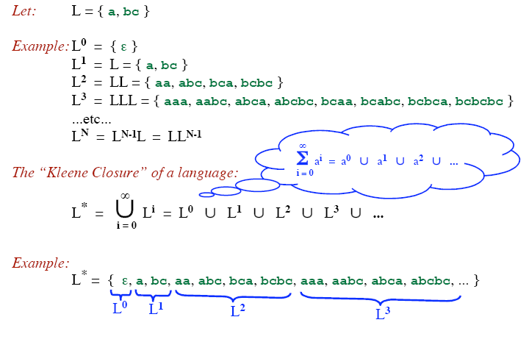
Kleene closure
L* denotes “zero or more concatenations of” L

Slide 17
Example
Let: L = { a, b, c, ..., z }
D = { 0, 1, 2, ..., 9 }
D⁺ = “The set of strings with one or more digits”
L ∪ D = “The set of all letters and digits (alphanumeric characters)”
LD = “The set of strings consisting of a letter followed by a digit”
L* = “The set of all strings of letters, including ε, the empty string”
( L ∪ D )* = “Sequences of zero or more letters and digits”
L ( ( L ∪ D )* ) = “Set of strings that start with a letter, followed by zero or more letters and digits.”

Slide 18
Rules for specifying Regular Expressions
Regular expressions over alphabet ∑
ε is a regular expression that denotes {ε}.
If a is a symbol (i.e., if a∈ ∑), then a is a regular expression that denotes {a}.
Suppose r and s are regular expressions denoting the languages L(r) and L(s). Then
(r) | (s) is a regular expression denoting L(r) U L(s).
(r)(s) is a regular expression denoting L(r)L(s).
(r)* is a regular expression denoting (L(r))*.
(r) is a regular expression denoting L(r).

Slide 19
How to “Parse” Regular Expressions
Precedence:
* has highest precedence.
Concatenation as middle precedence.
| has lowest precedence.
Use parentheses to override these rules.
Examples:
a b* = a (b*)
If you want (a b)* you must use parentheses.
a | b c = a | (b c)
If you want (a | b) c you must use parentheses.
Concatenation and | are associative.
(a b) c = a (b c) = a b c
(a | b) | c = a | (b | c) = a | b | c
Example:
b d | e f * | g a = (b d) | (e (f *)) | (g a)

Slide 20
Example
Let Σ = {a, b}
The regular expression a | b denotes the set {a, b}
The regular expression (a|b)(a|b) denotes {aa, ab, ba, bb}
The regular expression a* denotes the set of all strings of zero or more a’s. i.e., {ε, a, aa, aaa, ….. }
The regular expression (a|b)* denotes the set containing zero or more instances of an a or b.
The regular expression a|a*b denotes the set containing the string a and all strings consisting of zero or more a’s followed by one b.

Slide 21
Regular Definition
If Σ is an alphabet of basic symbols then a regular definition is a sequence of the following form:
d₁→r₁
d₂→r₂
……..
d_{n}→r_{n}
where
Each d_{i} is a new symbol such that d_{i} ∉ Σ and d_{i} ≠d_{j} where j < I
Each r_{i} is a regular expression over Σ ∪ {d₁,d₂,…,d_{i-1})

Slide 22
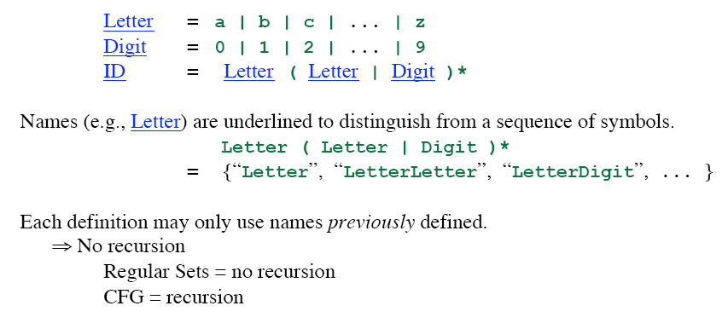
Regular Definition

Slide 23
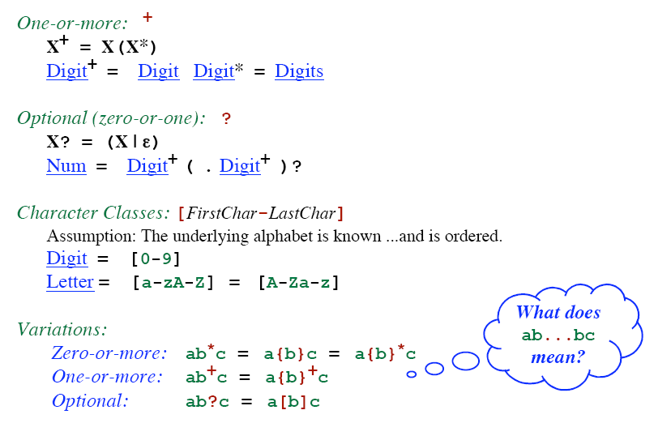
Addition Notation / Shorthand

Slide 24
Unsigned Number
1240, 39.45, 6.33E15, or 1.578E-41
digit → 0 | 1 | 2 | … | 9
digits → digit digit*
optional_fraction → . digits | ∈
optional_exponent → ( E ( + | -| ∈) digits) | ∈
num → digits optional_fraction optional_exponent
Shorthand
digit → 0 | 1 | 2 | … | 9
digits → digit⁺
optional_fraction → (. digits ) ?
optional_exponent → ( E ( + | -) ? digits) ?
num → digits optional_fraction optional_exponent

Slide 25
Some Other Examples
Telephone numbers of the form
(937)-775-5134
exchange = digit³
phone = digit⁴
area = digit³
phone_number = '(' area ')-' exchange '-' phone
Email address
violin@cs.wright.edu
??

Slide 26
Token Recognition
How can we use concepts developed so far to assist in recognizing tokens of a source language ?
Assume Following Tokens:
if, then, else, relop, id, num
Given Tokens, What are Patterns ?
Grammar: stmt → |if expr then stmt |if expr then stmt else stmt |∈ expr → term relop term | term term → id | num
if → if
then → then
else → else
relop → < | <= | > | >= | = | <>
id → letter ( letter | digit )*
num → digit ⁺ (. digit ⁺ ) ? ( E(+ | -) ? digit ⁺ ) ?

Slide 27
What Else Does Lexical Analyzer Do?
Scan away blanks, new lines, tabs
Can we Define Tokens For These?
blank → blank
tab → tab
newline → newline
delim → blank | tab | newline
ws → delim ⁺
In these cases no token is returned to parser

Slide 28
Overall
Regular Expression
Token
Attribute-Value
ws
if
then
else
id
num
<
<=
=
< >
>
>=
-
if
then
else
id
num
relop
relop
relop
relop
relop
relop
-
-
-
-
pointer to table entry
Exact value
LT
LE
EQ
NE
GT
GE
Note: Each token has a unique token identifier to define category of lexemes

Slide 29
Constructing Transition Diagrams for Tokens
Transition Diagrams (TD) are used to represent the tokens
As characters are read, the relevant TDs are used to attempt to match lexeme to a pattern
Each TD has:
States : Represented by Circles
Actions : Represented by Arrows between states
Start State : Beginning of a pattern (Arrowhead)
Final State(s) : End of pattern (Concentric Circles)
Edges: arrows connecting the states
Each TD is Deterministic (assume) - No need to choose between 2 different actions !

Slide 30
Example TDs
> = :
start
>
=
RTN(GE)
0
6
7
other
*
RTN(GT)
8
We’ve accepted “>” and have read one extra char that must be unread.

Slide 31
Example : All RELOPs
start
<
=
0
1
2
return(relop, LE)
>
3
return(relop, NE)
other
*
=
4
return(relop, LT)
5
return(relop, EQ)
>
=
6
7
return(relop, GE)
other
*
8
return(relop, GT)

Slide 32
Example TDs : id and delim
id :
letter or digit
start
letter
other
*
9
10
11
return( get_token(), install_id())
Either returns ptr or “0” if reserved
delim :
delim
start
delim
other
*
28
29
30

Slide 33
Example TDs : Unsigned #s
digit
digit
digit
start
digit
.
digit
E
+ | -
digit
other
*
12
13
14
15
16
17
18
19
E
digit
digit
digit
start
digit
*
.
digit
other
*
20
21
22
23
24
return(num, install_num())
digit
start
digit
other
*
25
26
27
Questions: Is ordering important for unsigned #s ?
Why are there no TDs for then, else, if ?

Slide 34
QUESTION :
What would the transition diagram (TD) for strings containing each vowel, in their strict lexicographical order, look like?

Slide 35
Answer
cons → B | C | D | F | G | H | J | … | N | P | … | T | V | .. | Z
string → cons* A cons* E cons* I cons* O cons* U cons*
cons
cons
cons
cons
cons
cons
start
A
E
I
O
U
other
accept
error
Note: The error path is taken if the character is other than a cons or the vowel in the lex order.

Slide 36
Capturing Multiple Tokens
Capturing keyword “begin”
start
b
e
g
i
n
WS
WS – white space
A – alphabetic
AN – alphanumeric
Capturing variable names
start
A
WS
AN
What if both need to happen at the same time?

Slide 37
Capturing Multiple Tokens
start
b
e
g
i
n
WS
A-b
AN
WS – white space
A – alphabetic
AN – alphanumeric
AN
WS
Machine is much more complicated – just for these two tokens!

Slide 38
Finite State Automata (FSAs)
“Finite State Machines”, “Finite Automata”, “FA”
A recognizer for a language is a program that takes as input a string x and answers “yes” if x is a sentence of the language and “no” otherwise.
The regular expression is compiled into a recognizer by constructing a generalized transition diagram called a finite automaton.
Each state is labeled with a state name
Directed edges, labeled with symbols
Two types
Deterministic (DFA)
Non-deterministic (NFA)

Slide 39
Nondeterministic Finite Automata
A nondeterministic finite automaton (NFA) is a mathematical model that consists of
A set of states S
A set of input symbols Σ
A transition function that maps state/symbol pairs to a set of states
A special state s₀ called the start state
A set of states F (subset of S) of final states
INPUT: string
OUTPUT: yes or no

Slide 40
Example – NFA : (a|b)*abb
S = { 0, 1, 2, 3 }
s₀ = 0
F = { 3 }
Σ = { a, b }
a
start
0
a
1
b
2
b
3
b
i n p u t
∈ (null) moves possible
a
b
state
0
{ 0, 1 }
{ 0 }
i
∈
j
1
--
{ 2 }
Switch state but do not use any input symbol
2
--
{ 3 }
Transition Table

Slide 41
How Does An NFA Work ?
a
start
0
a
1
b
2
b
3
b
Given an input string, we trace moves
If no more input & in final state, ACCEPT
EXAMPLE: Input: ababb
-OR-
move(0, a) = 0
move(0, b) = 0
move(0, a) = 1
move(1, b) = 2
move(2, b) = 3
ACCEPT !
move(0, a) = 1
move(1, b) = 2
move(2, a) = ? (undefined)
REJECT !

Slide 42
Handling Undefined Transitions
We can handle undefined transitions by defining one more state, a “death” state, and transitioning all previously undefined transition to this death state.
a
start
0
a
1
b
2
b
3
b
a
a
a, b
4
Σ

Slide 43
Other Concepts
Not all paths may result in acceptance.
a
start
0
a
1
b
2
b
3
b
aabb is accepted along path : 0 → 0 → 1 → 2 → 3
BUT… it is not accepted along the valid path:
0 → 0 → 0 → 0 → 0

Slide 44
Deterministic Finite Automata
A DFA is an NFA with the following restrictions:
∈ moves are not allowed
For every state s ∈S, there is one and only one path from s for every input symbol a ∈ Σ.
Since transition tables don’t have any alternative options, DFAs are easily simulated via an algorithm.
s ← s₀
c ← nextchar;
while c ≠ eof do
s ← move(s,c);
c ← nextchar;
end;
if s is in F then return “yes”
else return “no”

Slide 45
Example – DFA : (a|b)*abb
b
a
start
0
a
1
b
2
b
3
a
b
a
What Language is Accepted?
Recall the original NFA:
a
start
0
a
1
b
2
b
3
b

Slide 46
Relation between RE, NFA and DFA
There is an algorithm for converting any RE into an NFA.
There is an algorithm for converting any NFA to a DFA.
There is an algorithm for converting any DFA to a RE.
These facts tell us that REs, NFAs and DFAs have equivalent expressive power.
All three describe the class of regular languages.

Slide 47
NFA vs DFA
An NFA may be simulated by algorithm, when NFA is constructed from the R.E
Algorithm run time is proportional to |N| * |x| where |N| is the number of states and |x| is the length of input
Alternatively, we can construct DFA from NFA and uses it to recognize input
The space requirement of a DFA can be large. The RE (a+b)*a(a+b)(a+b)….(a+b) [n-1 (a+b) at the end] has no DFA with less than 2^{n} states. Fortunately, such RE in practice does not occur often
space required
time to simulate
NFA
O(|r|)
O(|r|*|x|)
DFA
O(2^{|r|})
O(|x|)
where |r| is the length of the regular expression.

Slide 48
Converting Regular Expressions to NFAs
Thompson’s Construction
Empty string ε is a regular expression denoting { ε }
a is a regular expression denoting {a} for any a in Σ
start
ε
i
f
start
a
i
f

Slide 49
Converting Regular Expressions to NFAs
If P and Q are regular expressions with NFAs N_{p}, N_{q}:
P | Q (union)
PQ (concatenation)
ε
N_{p}
ε
start
i
f
ε
N_{q}
ε
start
N_{p}
N_{q}
i
f

Slide 50
Converting Regular Expressions to NFAs
If Q is a regular expression with NFA N_{q}:
Q* (closure)
ε
start
ε
N_{q}
ε
i
f
ε

Slide 51
Example (ab* | a*b)*
Starting with:
ab*
start
a
a*b
start
b
1
2
3
4
b
a
ab* | a*b
a
ε
1
2
ε
start
5
b
6
ε
ε
3
b
4
a

Slide 52
Example (ab* | a*b)*
ab* | a*b
a
ε
1
2
ε
start
5
b
6
ε
ε
3
b
4
a
(ab* | a*b)*
a
ε
1
2
ε
start
ε
ε
7
5
b
6
8
ε
ε
ε
b
ε
3
4
a

Slide 53
Properties of Construction
Let r be a regular expression, with NFA N(r), then
N(r) has #of states ≤ 2*(#symbols + #operators) of r
N(r) has exactly one start and one accepting state
Each state of N(r) has at most one outgoing edge a∈Σ or at most two outgoing ∈-transition

Slide 54
Detailed Example
(ab*c) | (a(b|c*))
Parse Tree for this regular expression:
r₁₃
r₅
|
r₁₂
r₃
r₄
r₁₁
r₁₀
(
)
a
a
r₉
r₁
r₂
r₇
|
r₈
r₀
c
*
r₆
b
*
b
c
What is the NFA? Let’s construct it !

Slide 55
Detailed Example – Construction(1)
(ab*c) | (a(b|c*))
r₀:
b
∈
r₃:
a
r₁:
∈
b
∈
∈
r₂:
c
∈
r₄ : r₁ r₂
∈
b
∈
c
∈
∈
a
∈
b
∈
c
r₅ : r₃ r₄
∈

Slide 56
Detailed Example – Construction(2)
(ab*c) | (a(b|c*))
∈
r₇:
b
r₈:
∈
c
∈
r₁₁:
a
∈
b
r₆:
c
∈
∈
∈
r₉ : r₇ | r₈
∈
c
∈
∈
∈
∈
r₁₀ : r₉
b
∈
∈
∈
r₁₂ : r₁₁ r₁₀
a
∈
c
∈
∈
∈
∈

Slide 57
Detailed Example – Final Step
r₁₃ : r₅ | r₁₂
∈
a
∈
b
∈
c
2
3
4
5
6
7
∈
∈
∈
17
1
b
10
11
∈
∈
∈
∈
∈
a
∈
c
∈
8
9
12
13
14
15
16
∈
∈
∈

Slide 58
Converting NFAs to DFAs (subset construction)
Idea: Each state in the new DFA will correspond to some set of states from the NFA. The DFA will be in state {s₀,s₁,…} after input if the NFA could be in any of these states for the same input.
Input: NFA N with state set S_{N}, alphabet Σ, start state s_{N}, final states F_{N}, transition function T_{N}: S_{N} x {Σ U ε} → S_{N}
Output: DFA D with state set S_{D}, alphabet Σ, start state
s_{D} = ε-closure(s_{N}), final states F_{D}, transition function
T_{D}: S_{D} x Σ → S_{D}

Slide 59
Terminology: ε-closure
ε-closure(T) = T + all NFA states reachable from any state in T using only ε transitions.
b
1
2
b
b
ε-closure({1,2,5}) = {1,2,5}
ε-closure({4}) = {1,4}
ε-closure({3}) = {1,3,4}
ε-closure({3,5}) = {1,3,4,5}
a
ε
5
a
3
ε
4

Slide 60
Illustrating Conversion – An Example
Start with NFA: (a | b)*abb
∈
a
2
3
∈
∈
start
∈
∈
a
b
0
1
6
7
8
9
∈
b
∈
∈
b
4
5
10
∈
First we calculate: ∈-closure(0) (i.e., state 0)
∈-closure(0) = {0, 1, 2, 4, 7} (all states reachable from 0
on ∈-moves)
Let A={0, 1, 2, 4, 7} be a state of new DFA, D.

Slide 61
Conversion Example – continued (1)
2nd , we calculate : a : ∈-closure(move(A,a)) and
b : ∈-closure(move(A,b))
a : ∈-closure(move(A,a)) = ∈-closure(move({0,1,2,4,7},a))}
adds {3,8} ( since move(2,a)=3 and move(7,a)=8)
From this we have : ∈-closure({3,8}) = {1,2,3,4,6,7,8}
(since 3→6 →1 →4, 6 →7, and 1 →2 all by ∈-moves)
Let B={1,2,3,4,6,7,8} be a new state. Define Dtran[A,a] = B.
b : ∈-closure(move(A,b)) = ∈-closure(move({0,1,2,4,7},b))
adds {5} ( since move(4,b)=5)
From this we have : ∈-closure({5}) = {1,2,4,5,6,7}
(since 5→6 →1 →4, 6 →7, and 1 →2 all by ∈-moves)
Let C={1,2,4,5,6,7} be a new state. Define Dtran[A,b] = C.

Slide 62
Conversion Example – continued (2)
3rd , we calculate for state B on {a,b}
a : ∈-closure(move(B,a)) = ∈-closure(move({1,2,3,4,6,7,8},a))}
= {1,2,3,4,6,7,8} = B
Define Dtran[B,a] = B.
b : ∈-closure(move(B,b)) = ∈-closure(move({1,2,3,4,6,7,8},b))}
= {1,2,4,5,6,7,9} = D
Define Dtran[B,b] = D.
4th , we calculate for state C on {a,b}
a : ∈-closure(move(C,a)) = ∈-closure(move({1,2,4,5,6,7},a))}
= {1,2,3,4,6,7,8} = B
Define Dtran[C,a] = B.
b : ∈-closure(move(C,b)) = ∈-closure(move({1,2,4,5,6,7},b))}
= {1,2,4,5,6,7} = C
Define Dtran[C,b] = C.

Slide 63
Conversion Example – continued (3)
5th , we calculate for state D on {a,b}
a : ∈-closure(move(D,a)) = ∈-closure(move({1,2,4,5,6,7,9},a))}
= {1,2,3,4,6,7,8} = B
Define Dtran[D,a] = B.
b : ∈-closure(move(D,b)) = ∈-closure(move({1,2,4,5,6,7,9},b))}
= {1,2,4,5,6,7,10} = E
Define Dtran[D,b] = E.
Finally, we calculate for state E on {a,b}
a : ∈-closure(move(E,a)) = ∈-closure(move({1,2,4,5,6,7,10},a))}
= {1,2,3,4,6,7,8} = B
Define Dtran[E,a] = B.
b : ∈-closure(move(E,b)) = ∈-closure(move({1,2,4,5,6,7,10},b))}
= {1,2,4,5,6,7} = C
Define Dtran[E,b] = C.

Slide 64
Conversion Example – continued (4)
This gives the transition table Dtran for the DFA of:
Input Symbol
Dstates
a
b
A B C
B B D
C B C
D B E
E B C
b
b
C
b
start
A
a
B
b
D
b
E
a
a
a

Slide 65
Algorithm For Subset Construction
push all states in T onto stack;
initialize ∈-closure(T) to T;
while stack is not empty do begin
pop t, the top element, off the stack;
for each state u with edge from t to u labeled ∈ do
if u is not in ∈-closure(T) do begin
add u to ∈-closure(T) ;
push u onto stack
end
end
computing the
∈-closure

Slide 66
Algorithm For Subset Construction – (2)
initially, ∈-closure(s₀) is only (unmarked) state in Dstates;
while there is unmarked state T in Dstates do begin
mark T;
for each input symbol a do begin
U := ∈-closure(move(T,a));
if U is not in Dstates then
add U as an unmarked state to Dstates;
Dtran[T,a] := U
end
end

Slide 67
Example 2: Subset Construction
NFA N with
State set S_{N} = {1,2,3,4,5},
Alphabet Σ = {a,b}
Start state s_{N}=1,
Final states F_{N}={5},
Transition function T_{N}: S_{N} x {Σ ∪ ε} → S_{N}
NFA
start
ε
1
2
a,b
a
b
5
a,b
3
4
 | a | b | ε
1 | 3 | - | 2
2 | 5 | 5, 4 | -
3 | - | 4 | -
4 | 5 | 5 | -
5 | - | - | -
b

Slide 68
Example 2: Subset Construction
NFA
start
1,2
start
ε
1
2
a,b
a
b
5
a,b
3
4
T | ∈-closure(move(T, a)) | ∈-closure(move(T, b))
{1,2}
b

Slide 69
Example 2: Subset Construction
NFA
start
b
1,2
4,5
start
ε
a
1
2
a,b
a
b
5
3,5
a,b
T | ∈-closure(move(T, a)) | ∈-closure(move(T, b))
{1,2} | {3,5} | {4,5}
{3,5}
{4,5}
3
4
b

Slide 70
Example 2: Subset Construction
NFA
start
b
1,2
4,5
start
ε
a
1
2
a,b
b
3,5
b
4
a
5
a,b
T | ∈-closure(move(T, a)) | ∈-closure(move(T, b))
{1,2} | {3,5} | {4,5}
{3,5} | - | {4}
{4,5}
{4}
3
4
b

Slide 71
Example 2: Subset Construction
NFA
start
b
a,b
1,2
4,5
5
start
ε
a
1
2
a,b
b
3,5
b
4
a
5
a,b
T | ∈-closure(move(T, a)) | ∈-closure(move(T, b))
{1,2} | {3,5} | {4,5}
{3,5} | - | {4}
{4,5} | {5} | {5}
{4}
{5}
3
4
b

Slide 72
Example 2: Subset Construction
NFA
start
b
a,b
1,2
4,5
5
start
ε
a
a,b
1
2
a,b
b
3,5
b
4
a
5
a,b
T | ∈-closure(move(T, a)) | ∈-closure(move(T, b))
{1,2} | {3,5} | {4,5}
{3,5} | - | {4}
{4,5} | {5} | {5}
{4} | {5} | {5}
{5} | - | -
3
4
b

Slide 73
Example 2: Subset Construction
start
b
1,2
4,5
a,b
5
NFA
a
a,b
start
ε
b
1
2
a,b
3,5
4
a
b
5
a,b
T | ∈-closure(move(T, a)) | ∈-closure(move(T, b))
{1,2} | {3,5} | {4,5}
{3,5} | - | {4}
{4,5} | {5} | {5}
{4} | {5} | {5}
{5} | - | -
3
4
b
All final states since the
NFA final state is included

Slide 74
Example 3: Subset Construction
NFA
start
b
1
2
b
a
ε
b
5
a
3
ε
4

Slide 75
Example 3: Subset Construction
NFA
DFA
start
b
start
a
1
2
b
1
1,3,4
ε
b
5
b
b
a
a
a
2
b
a
3
4
1,3,
4,5
ε
b
b
a
1,4,5

Slide 76
Example 4: Subset Construction
NFA
DFA
start
b
ε
b
start
1
2
a
3
5
1,2,4
ε
a
b
b
b
3,4
3,5
3
a
4
5
b
b
a
4
a

Slide 77
Thank You
Any Questions?

